Slide 1

Recursive Exploration
Chris Piech
CS 106B
Lecture 8
Jan 25, 2016

Slide 2

Assignment 3
Due: Feb 3rd

Slide 3

Assignment 3
In order to learn recursion, you will teach recursion.
In order to teach recursion, you must first learn recursion.

Slide 4
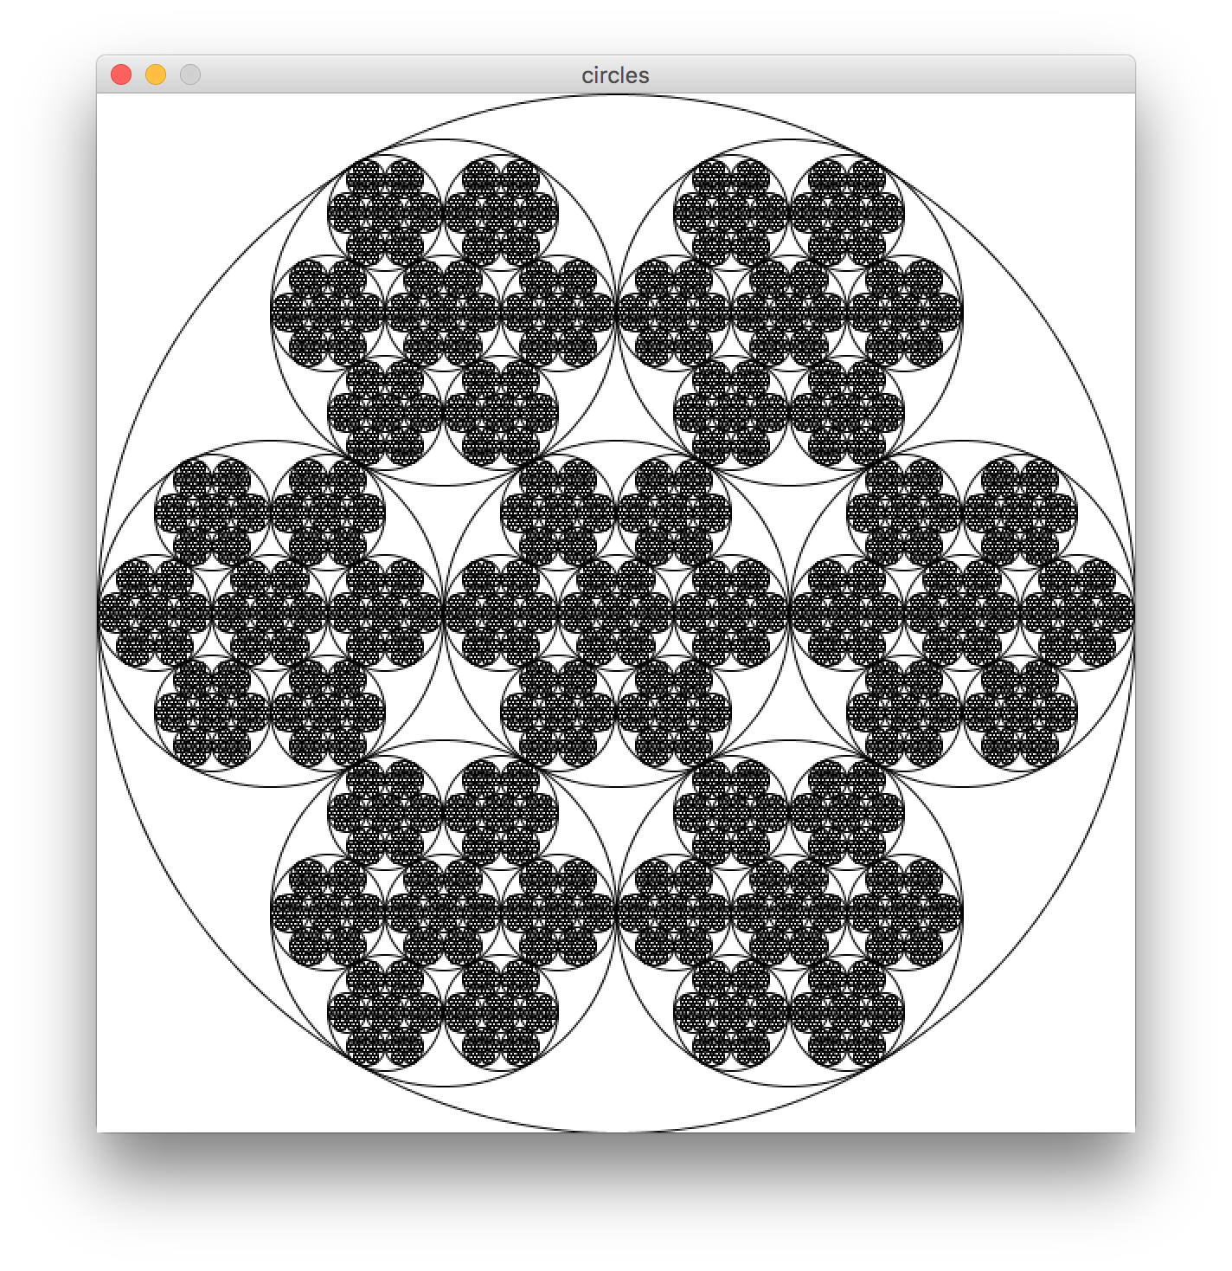
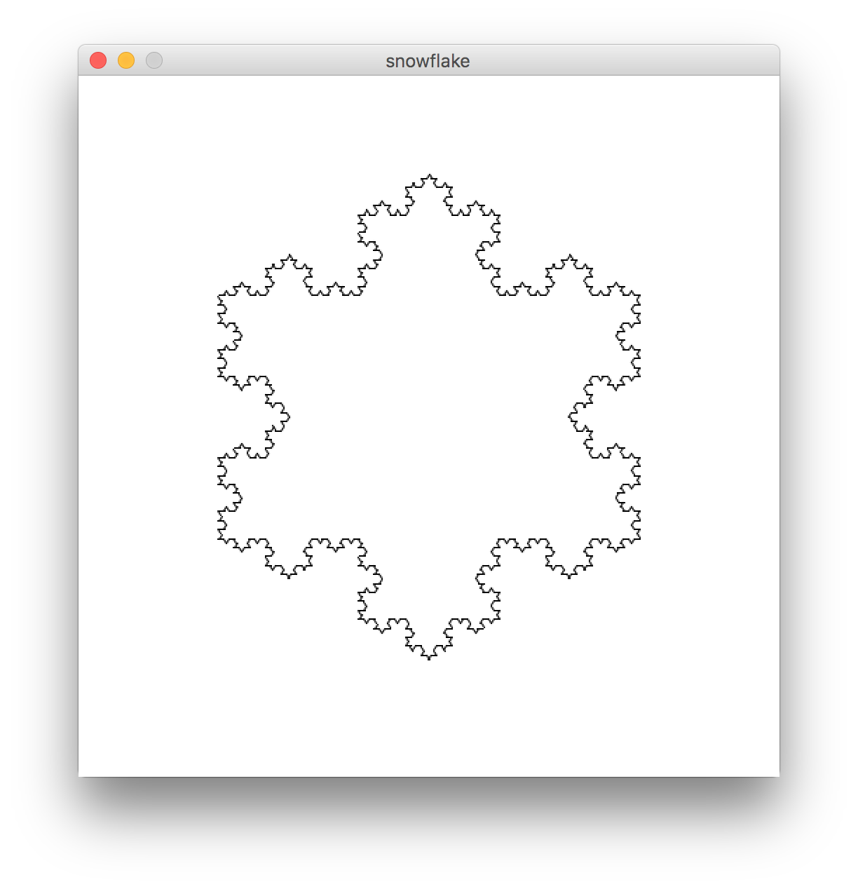
Extra Fractal Examples
circles
koch

Slide 5


Slide 6
Recursive
Ray Tracing

Slide 7
Flavors of Recursion
Recursion
Recursive
definition
Fractals

Slide 8
Flavors of Recursion
Recursion
Recursive
definition
Fractals
Recursive
exploration

Slide 9

Today’s Goal
Introduction to decision trees.

Slide 10

Today’s Route
Monday
Many
Examples
framework
9 Letters
Decision
trees
Exploration River

Slide 11

Today’s Route
Monday
Many
Examples
framework
9 Letters
Decision
trees
Exploration River

Slide 12
Lets talk about your life decisions

Slide 13
Decision Tree
Undergrad

Slide 14
Decision Tree
Undergrad
Oceanography
Native Studies
CS

Slide 15
Decision Tree
Undergrad
Oceanography
Native Studies
CS
AI
HCI
Graphics
CompBio

Slide 16
Decision Tree
Undergrad
Oceanography
Native Studies
CS
AI
HCI
Graphics
CompBio
Research
Startup

Slide 17
Decision Tree
Undergrad
Oceanography
Native Studies
CS
AI
HCI
Graphics
CompBio
Research
Startup

Slide 18
Aside

Slide 19
Less important then say love

Slide 20
But the love decision tree is more complex

Slide 21
End aside

Slide 22
Decision Tree
Undergrad
Oceanography
Native Studies
CS
AI
HCI
Graphics
CompBio
Research
Startup

Slide 23
Why Decision Tree?

Slide 24
Decision Tree
Undergrad
Oceanography
Native Studies
CS
AI
HCI
Graphics
CompBio
Research
Startup

Slide 25
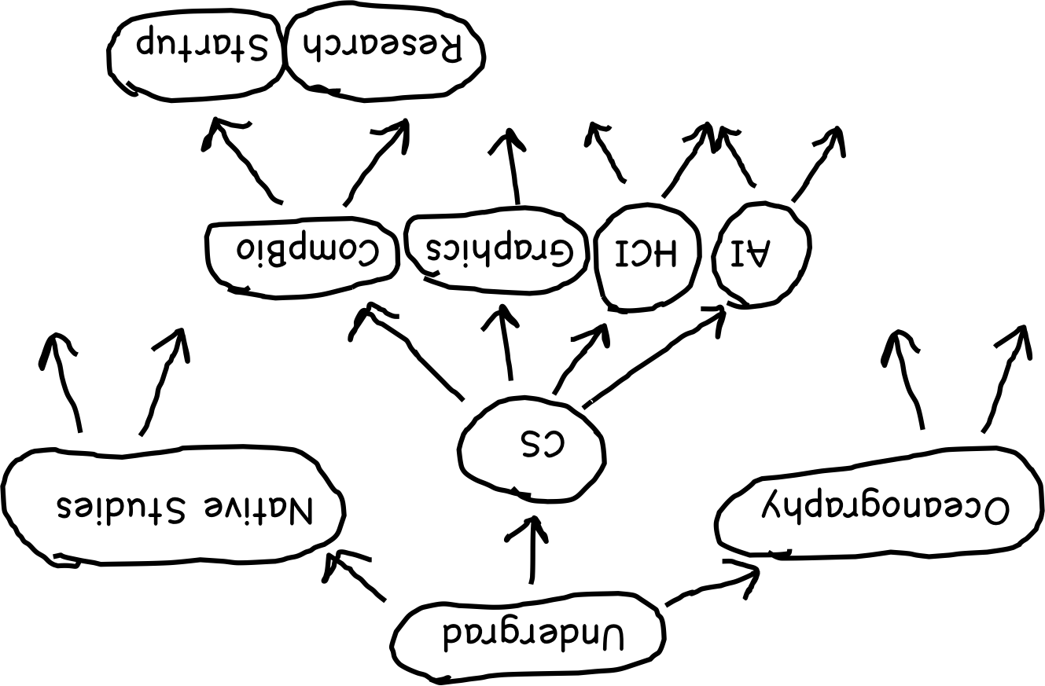
Decision Tree

Slide 26
Decision Tree

Slide 27
Decision Tree

Slide 28
Decision Tree
Undergrad
Oceanography
Native Studies
CS
AI
HCI
Graphics
CompBio
Research
Startup

Slide 29
Decision Trees are Recursive

Slide 30
Decision Tree
Undergrad
Oceanography
Native Studies
CS
AI
HCI
Graphics
CompBio
Research
Startup

Slide 31
Decision Tree
Undergrad
Oceanography
Native Studies
CS
AI
HCI
Graphics
CompBio
Research
Startup

Slide 32
Decision Tree
Current
state

Slide 33
Decision Tree
Current
state
Option 0
Option n
Option 1

Slide 34
Decision Tree
Current
state
Option 0
Option n
Option 1
Next
state 0
Next
state n
Next
state 1

Slide 35
Decision Tree
Next
state 1

Slide 36
Decision Tree
Next
state 1
Option 0
Option m
Option 1

Slide 37
Recursion is a great tool for exploring decisions

Slide 38
Output all paths

Slide 39
Output all Paths
void outputAllPaths(Vector<string> soFar) {
if(endOfUndergrad(soFar)) {
cout << soFar << endl;
} else {
Set<string> options = getOptions(soFar);
for(string option : options) {
Vector<string> next = soFar;
next.add(option);
outputAllPaths(next);
}
}
}

Slide 40
Output all Paths
void outputAllPaths(Vector<string> soFar) {
if(endOfUndergrad(soFar)) {
cout << soFar << endl;
} else {
Set<string> options = getOptions(soFar);
for(string option : options) {
Vector<string> next = soFar;
next.add(option);
outputAllPaths(next);
}
}
}

Slide 41
Output all Paths
void outputAllPaths(Vector<string> soFar) {
if(endOfUndergrad(soFar)) {
cout << soFar << endl;
} else {
Set<string> options = getOptions(soFar);
for(string option : options) {
Vector<string> next = soFar;
next.add(option);
outputAllPaths(next);
}
}
}

Slide 42
Output all Paths
void outputAllPaths(Vector<string> soFar) {
if(endOfUndergrad(soFar)) {
cout << soFar << endl;
} else {
Set<string> options = getOptions(soFar);
for(string option : options) {
Vector<string> next = soFar;
next.add(option);
outputAllPaths(next);
}
}
}
Current
state
Option 0
Option n
Option 1
Next
state 0
Next
state n
Next
state 1

Slide 43

Recursive Exploration

Slide 44

Recursive Exploration
Has other names
Recursive Depth First Search
Try Everything Search
Recursive Backtracking (subset)

Slide 45
Today’s Route
Wednesday
Many
Examples
framework
9 Letters
Decision
trees
Exploration River

Slide 46
Today’s Route
Wednesday
Many
Examples
framework
9 Letters
Decision
trees
Exploration River

Slide 47
A Little Word Puzzle

Slide 48
“What nine-letter word can be reduced to a single-letter word one letter at a time by removing letters, leaving it a legal word at each step?”

Slide 49
The Startling Truth
S
T
A
R
T
L
I
N
G

Slide 50
The Startling Truth
S
T
A
R
T
I
N
G

Slide 51
The Startling Truth
S
T
A
R
I
N
G

Slide 52
The Startling Truth
S
T
R
I
N
G

Slide 53
The Startling Truth
S
T
I
N
G

Slide 54
The Startling Truth
S
I
N
G

Slide 55
The Startling Truth
S
I
N

Slide 56
The Startling Truth
I
N

Slide 57
The Startling Truth
I

Slide 58
Is there really just one nine-letter word with this property?

Slide 59
Iterative?

Slide 60
Recursive?

Slide 61
Decision Tree?

Slide 62
Reduce Decision Tree
CART

Slide 63
Reduce Decision Tree
CART
ART
CRT
CAT
CAR

Slide 64
Reduce Decision Tree
CART
ART
CRT
CAT
CAR
RT
AT
AR

Slide 65
Reduce Decision Tree
CART
ART
CRT
CAT
CAR
RT
AT
AR
RT
CT
CR
AT
CT
CA
AR
CR
CA
T
R
T
A
R
A
T
R
T
C
R
C
T
A
T
C
A
C
R
A
R
C
A
C

Slide 66
Reduce Decision Tree
CART
ART
CRT
CAT
CAR
RT
AT
AR
RT
CT
CR
AT
CT
CA
AR
CR
CA
T
R
T
A
R
A
T
R
T
C
R
C
T
A
T
C
A
C
R
A
R
C
A
C

Slide 67
Decision Tree Search
bool search(currentState) {
if(isSolution(currentState)) {
return true;
} else {
for(option : moves from currentState) {
nextState = takeOption(curr, option);
if(search(nextState)){
return true;
}
}
return false;
}
}

Slide 68
Reducible Word
Let's define a reducible word as a word that can be reduced down to one letter by removing one character at a time, leaving a word at each step.
Base Cases:
The empty string
Recursive Step:
Any multi-letter word is reducible if you can remove a letter (legal move) to form a shrinkable word.

Slide 69
Decision Tree Search
bool reducible(Lexicon & lex, string word) {
if(word.length()==1 && lex.contains(word)){
return true;
} else {
for(int i=0; i < word.length(); i++) {
string copy = word;
copy.erase(i, 1);
if(lex.contains(copy)){
if(reducible(lex, copy)){
return true;
}
}
}
return false;
}
}

Slide 70
Decision Tree Search
bool reducible(Lexicon & lex, string word) {
if(word.length()==1 && lex.contains(word)){
return true;
} else {
for(int i=0; i < word.length(); i++) {
string copy = word;
copy.erase(i, 1);
if(lex.contains(copy)){
if(reducible(lex, copy)){
return true;
}
}
}
return false;
}
}
Get all legal moves, and corresponding next states

Slide 71
Decision Tree Search
bool reducible(Lexicon & lex, string word) {
if(word.length()==1 && lex.contains(word)){
return true;
} else {
for(int i=0; i < word.length(); i++) {
string copy = word;
copy.erase(i, 1);
if(lex.contains(copy)){
if(reducible(lex, copy)){
return true;
}
}
}
return false;
}
}
Get all legal moves, and corresponding next states

Slide 72
Decision Tree Search
bool reducable(Lexicon & lex, string word) {
if(word.length()==1 && lex.contains(word)){
return true;
} else {
for(int i=0; i < word.length(); i++) {
string copy = word;
copy.erase(i, 1);
if(lex.contains(copy)){
if(reducable(lex, copy)){
return true;
}
}
}
return false;
}
}
If any decision is reducible return true

Slide 73
Decision Tree Search
bool reducable(Lexicon & lex, string word) {
if(word.length()==1 && lex.contains(word)){
return true;
} else {
for(int i=0; i < word.length(); i++) {
string copy = word;
copy.erase(i, 1);
if(lex.contains(copy)){
if(reducable(lex, copy)){
return true;
}
}
}
return false;
}
}
Only return false if every single option failed.

Slide 74

Is there really just one nine-letter word with this property?

Slide 75
Recursive Exploration
The function we have just defined is an example of recursive exploration. In this case we are looking for any path through the decision tree. For a given state:
If any option leads to succeeds, that's great! We're done.
If none of the options succeed, then this particular problem can't be solved from the state.

Slide 76
Recursive Exploration
CART
ART
CRT
CAT
CAR
RT
AT
AR
RT
CT
CR
AT
CT
CA
AR
CR
CA
T
R
T
A
R
A
T
R
T
C
R
C
T
A
T
C
A
C
R
A
R
C
A
C

Slide 77
Recursive Exploration
CART
ART
CRT
CAT
CAR
RT
AT
AR
RT
CT
CR
AT
CT
CA
AR
CR
CA
T
R
T
A
R
A
T
R
T
C
R
C
T
A
T
C
A
C
R
A
R
C
A
C

Slide 78
Recursive Exploration
CART
ART
CRT
CAT
CAR
RT
AT
AR
RT
CT
CR
AT
CT
CA
AR
CR
CA
T
R
T
A
R
A
T
R
T
C
R
C
T
A
T
C
A
C
R
A
R
C
A
C

Slide 79
Recursive Exploration
CART
ART
CRT
CAT
CAR
RT
AT
AR
RT
CT
CR
AT
CT
CA
AR
CR
CA
T
R
T
A
R
A
T
R
T
C
R
C
T
A
T
C
A
C
R
A
R
C
A
C

Slide 80
Recursive Exploration
CART
ART
CRT
CAT
CAR
RT
AT
AR
RT
CT
CR
AT
CT
CA
AR
CR
CA
T
R
T
A
R
A
T
R
T
C
R
C
T
A
T
C
A
C
R
A
R
C
A
C

Slide 81
Recursive Exploration
CART
ART
CRT
CAT
CAR
RT
AT
AR
RT
CT
CR
AT
CT
CA
AR
CR
CA
T
R
T
A
R
A
T
R
T
C
R
C
T
A
T
C
A
C
R
A
R
C
A
C

Slide 82
Recursive Exploration
CART
ART
CRT
CAT
CAR
RT
AT
AR
RT
CT
CR
AT
CT
CA
AR
CR
CA
T
R
T
A
R
A
T
R
T
C
R
C
T
A
T
C
A
C
R
A
R
C
A
C

Slide 83
Recursive Exploration
CART
ART
CRT
CAT
CAR
RT
AT
AR
RT
CT
CR
AT
CT
CA
AR
CR
CA
T
R
T
A
R
A
T
R
T
C
R
C
T
A
T
C
A
C
R
A
R
C
A
C

Slide 84
Recursive Exploration
CART
ART
CRT
CAT
CAR
RT
AT
AR
RT
CT
CR
AT
CT
CA
AR
CR
CA
T
R
T
A
R
A
T
R
T
C
R
C
T
A
T
C
A
C
R
A
R
C
A
C

Slide 85
Recursive Exploration
CART
ART
CRT
CAT
CAR
RT
AT
AR
RT
CT
CR
AT
CT
CA
AR
CR
CA
T
R
T
A
R
A
T
R
T
C
R
C
T
A
T
C
A
C
R
A
R
C
A
C

Slide 86
Recursive Exploration
CART
ART
CRT
CAT
CAR
RT
AT
AR
RT
CT
CR
AT
CT
CA
AR
CR
CA
T
R
T
A
R
A
T
R
T
C
R
C
T
A
T
C
A
C
R
A
R
C
A
C

Slide 87
Recursive Exploration
CART
ART
CRT
CAT
CAR
RT
AT
AR
RT
CT
CR
AT
CT
CA
AR
CR
CA
T
R
T
A
R
A
T
R
T
C
R
C
T
A
T
C
A
C
R
A
R
C
A
C

Slide 88
Recursive Exploration
CART
ART
CRT
CAT
CAR
RT
AT
AR
RT
CT
CR
AT
CT
CA
AR
CR
CA
T
R
T
A
R
A
T
R
T
C
R
C
T
A
T
C
A
C
R
A
R
C
A
C

Slide 89
Recursive Exploration
CART
ART
CRT
CAT
CAR
RT
AT
AR
RT
CT
CR
AT
CT
CA
AR
CR
CA
T
R
T
A
R
A
T
R
T
C
R
C
T
A
T
C
A
C
R
A
R
C
A
C

Slide 90
Only Need One Path
S
T
A
R
T
L
I
N
G

Slide 91
Only Need One Path
S
T
A
R
T
L
I
N
G
T
A
R
T
L
I
N
G

Slide 92
Only Need One Path
S
T
A
R
T
L
I
N
G
T
A
R
T
L
I
N
G

Slide 93
Only Need One Path
S
T
A
R
T
L
I
N
G

Slide 94
Only Need One Path
S
T
A
R
T
L
I
N
G
S
A
R
T
L
I
N
G

Slide 95
Only Need One Path
S
T
A
R
T
L
I
N
G
S
A
R
T
L
I
N
G

Slide 96
Only Need One Path
S
T
A
R
T
L
I
N
G

Slide 97
Only Need One Path
S
T
A
R
T
L
I
N
G
S
T
R
T
L
I
N
G

Slide 98
Only Need One Path
S
T
A
R
T
L
I
N
G
S
T
R
T
L
I
N
G

Slide 99
Only Need One Path
S
T
A
R
T
L
I
N
G

Slide 100
Only Need One Path
S
T
A
R
T
L
I
N
G
S
T
A
T
L
I
N
G

Slide 101
Only Need One Path
S
T
A
R
T
L
I
N
G
S
T
A
T
L
I
N
G

Slide 102
Only Need One Path
S
T
A
R
T
L
I
N
G

Slide 103
Only Need One Path
S
T
A
R
T
L
I
N
G
S
T
A
R
L
I
N
G

Slide 104
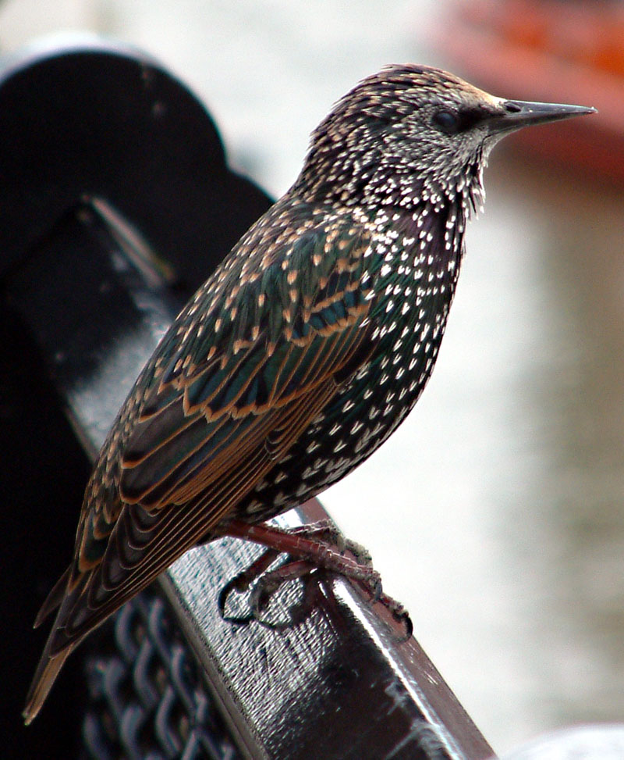
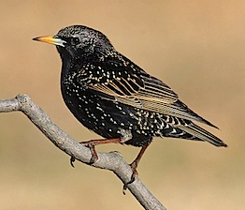
Only Need One Path
S
T
A
R
T
L
I
N
G
S
T
A
R
L
I
N
G
Sources: http://www.rubyinside.com/wp-content/uploads/2008/07/starling.jpg and http://2.bp.blogspot.com/-hCzVof1xqWo/TvaFXmpJAmI/AAAAAAAAIdk/QzUg1sKHDnA/s1600/1+Common_starling_in_london+paul+lomax+wiki+commons.jpg

Slide 105
Only Need One Path
S
T
A
R
T
L
I
N
G
S
T
A
R
L
I
N
G
T
A
R
L
I
N
G

Slide 106
Only Need One Path
S
T
A
R
T
L
I
N
G
S
T
A
R
L
I
N
G
T
A
R
L
I
N
G

Slide 107
Only Need One Path
S
T
A
R
T
L
I
N
G
S
T
A
R
L
I
N
G

Slide 108
Only Need One Path
S
T
A
R
T
L
I
N
G
S
T
A
R
L
I
N
G
S
A
R
L
I
N
G

Slide 109
Only Need One Path
S
T
A
R
T
L
I
N
G
S
T
A
R
L
I
N
G
S
A
R
L
I
N
G

Slide 110
Decision Tree Search
bool reducible(Lexicon & lex, string word) {
if(word.length()==1 && lex.contains(word)){
return true;
} else {
for(int i=0; i < word.length(); i++) {
string copy = word;
copy.erase(i, 1);
if(lex.contains(copy)){
if(reducible(lex, copy)){
return true;
}
}
}
return false;
}
}

Slide 111
Ur Doin it Rong!
bool reducible(Lexicon & lex, string word) {
if(word.length()==1 && lex.contains(word)){
return true;
} else {
for(int i=0; i < word.length(); i++) {
string copy = word;
copy.erase(i, 1);
if(lex.contains(copy)){
if(!reducible(lex, copy)){
return false;
}
}
}
return true;
}
}
Note how the true
became a false

Slide 112
Ur Doin It Rong!
CART
ART
CRT
CAT
CAR
RT
AT
AR
RT
CT
CR
AT
CT
CA
AR
CR
CA
T
R
T
A
R
A
T
R
T
C
R
C
T
A
T
C
A
C
R
A
R
C
A
C

Slide 113
Ur Doin It Rong!
CART
ART
CRT
CAT
CAR
RT
AT
AR
RT
CT
CR
AT
CT
CA
AR
CR
CA
T
R
T
A
R
A
T
R
T
C
R
C
T
A
T
C
A
C
R
A
R
C
A
C

Slide 114
Ur Doin It Rong!
CART
ART
CRT
CAT
CAR
RT
AT
AR
RT
CT
CR
AT
CT
CA
AR
CR
CA
T
R
T
A
R
A
T
R
T
C
R
C
T
A
T
C
A
C
R
A
R
C
A
C

Slide 115
Ur Doin It Rong!
CART
ART
CRT
CAT
CAR
RT
AT
AR
RT
CT
CR
AT
CT
CA
AR
CR
CA
T
R
T
A
R
A
T
R
T
C
R
C
T
A
T
C
A
C
R
A
R
C
A
C

Slide 116
Ur Doin It Rong!
CART
ART
CRT
CAT
CAR
RT
AT
AR
RT
CT
CR
AT
CT
CA
AR
CR
CA
T
R
T
A
R
A
T
R
T
C
R
C
T
A
T
C
A
C
R
A
R
C
A
C

Slide 117
Ur Doin It Rong!
CART
ART
CRT
CAT
CAR
RT
AT
AR
RT
CT
CR
AT
CT
CA
AR
CR
CA
T
R
T
A
R
A
T
R
T
C
R
C
T
A
T
C
A
C
R
A
R
C
A
C

Slide 118
Ur Doin It Rong!
CART
ART
CRT
CAT
CAR
RT
AT
AR
RT
CT
CR
AT
CT
CA
AR
CR
CA
T
R
T
A
R
A
T
R
T
C
R
C
T
A
T
C
A
C
R
A
R
C
A
C

Slide 119
Ur Doin It Rong!
CART
ART
CRT
CAT
CAR
RT
AT
AR
RT
CT
CR
AT
CT
CA
AR
CR
CA
T
R
T
A
R
A
T
R
T
C
R
C
T
A
T
C
A
C
R
A
R
C
A
C

Slide 120
Today’s Route
Wednesday
Many
Examples
framework
9 Letters
Decision
trees
Exploration River

Slide 121
Today’s Route
Wednesday
Many
Examples
framework
9 Letters
Decision
trees
Exploration River

Slide 122
Many problems can be seen as decision trees

Slide 123
Decision Tree
Undergrad
Oceanography
Native Studies
CS
AI
HCI
Graphics
CompBio
Research
Startup

Slide 124
Art of seeing decision trees

Slide 125
Templates for working with a decision tree.

Slide 126
How to Formulate as Decision Tree
Four questions!

Slide 127
How to Formulate as Decision Tree
1. How do you represent
a current state?
2. How do you calculate
legal moves?
3. How do you generate
next states given move?
4. How do you know if you
should stop recursing?

Slide 128
Generating Permutations
All permutations of “abcd”

Slide 129
Generating Permutations
x₁
x₂
x₃
x₄
x₁
x₂
x₃
x₄
x₁
x₂
x₂
x₁
x₃
x₄
x₃
x₁
x₂
x₄
x₄
x₁
x₂
x₃
x₁
x₂
x₄
x₃
x₁
x₂
x₂
x₁
x₄
x₃
x₁
x₃
x₂
x₁
x₄
x₃
x₂
x₁
x₄
x₂
x₁
x₄
x₃
x₃
x₂
x₁
x₃
x₂
x₄
x₁
x₂
x₃
x₂
x₁
x₄
x₁
x₃
x₃
x₂
x₂
x₁
x₄
x₁
x₄
x₃
x₂
x₂
x₁
x₄
x₃
x₁
x₃
x₄
x₂
x₁
x₂
x₃
x₄
x₂
x₁
x₁
x₃
x₃
x₂
x₄
x₂
x₁
x₁
x₄
x₃
x₂
x₄
x₃
x₂
x₁
x₁
x₄
x₂
x₃
x₁
x₂
x₄
x₂
x₁
x₃
x₁
x₃
x₄
x₂
x₁
x₃
x₂
x₁
x₄
x₄
x₃
x₂
x₁
x₃
x₂
x₁
x₄
x₃
x₂
x₁
x₂
x₄
x₃
x₂
x₁
x₁
x₃
x₄
x₃
x₂
x₂
x₁
x₁
x₄
x₄
x₃
x₃
x₂
x₂
x₁

Slide 130
Generating Permutations
x₁
x₂
x₃
x₄
x₁
x₂
x₃
x₄
x₁
x₂
x₂
x₁
x₃
x₄
x₃
x₁
x₂
x₄
x₄
x₁
x₂
x₃
x₁
x₂
x₄
x₃
x₁
x₂
x₂
x₁
x₄
x₃
x₁
x₃
x₂
x₁
x₄
x₃
x₂
x₁
x₄
x₂
x₁
x₄
x₃
x₃
x₂
x₁
x₃
x₂
x₄
x₁
x₂
x₃
x₂
x₁
x₄
x₁
x₃
x₃
x₂
x₂
x₁
x₄
x₁
x₄
x₃
x₂
x₂
x₁
x₄
x₃
x₁
x₃
x₄
x₂
x₁
x₂
x₃
x₄
x₂
x₁
x₁
x₃
x₃
x₂
x₄
x₂
x₁
x₁
x₄
x₃
x₂
x₄
x₃
x₂
x₁
x₁
x₄
x₂
x₃
x₁
x₂
x₄
x₂
x₁
x₃
x₁
x₃
x₄
x₂
x₁
x₃
x₂
x₁
x₄
x₄
x₃
x₂
x₁
x₃
x₂
x₁
x₄
x₃
x₂
x₁
x₂
x₄
x₃
x₂
x₁
x₁
x₃
x₄
x₃
x₂
x₂
x₁
x₁
x₄
x₄
x₃
x₃
x₂
x₂
x₁

Slide 131
Generating Permutations
Generating Permutations
x₁
x₂
x₃
x₄
x₁
x₂
x₃
x₄
x₁
x₂
x₂
x₁
x₃
x₄
x₃
x₁
x₂
x₄
x₄
x₁
x₂
x₃
x₁
x₂
x₄
x₃
x₁
x₂
x₂
x₁
x₄
x₃
x₁
x₃
x₂
x₁
x₄
x₃
x₂
x₁
x₄
x₂
x₁
x₄
x₃
x₃
x₂
x₁
x₃
x₂
x₄
x₁
x₂
x₃
x₂
x₁
x₄
x₁
x₃
x₃
x₂
x₂
x₁
x₄
x₁
x₄
x₃
x₂
x₂
x₁
x₄
x₃
x₁
x₃
x₄
x₂
x₁
x₂
x₃
x₄
x₂
x₁
x₁
x₃
x₃
x₂
x₄
x₂
x₁
x₁
x₄
x₃
x₂
x₄
x₃
x₂
x₁
x₁
x₄
x₂
x₃
x₁
x₂
x₄
x₂
x₁
x₃
x₁
x₃
x₄
x₂
x₁
x₃
x₂
x₁
x₄
x₄
x₃
x₂
x₁
x₃
x₂
x₁
x₄
x₃
x₂
x₁
x₂
x₄
x₃
x₂
x₁
x₁
x₃
x₄
x₃
x₂
x₂
x₁
x₁
x₄
x₄
x₃
x₃
x₂
x₂
x₁

Slide 132
Generating Permutations
x₁
x₂
x₃
x₄
x₁
x₂
x₃
x₄
x₁
x₂
x₁
x₂
x₂
x₁
x₂
x₁
x₃
x₃
x₄
x₄
x₃
x₁
x₂
x₄
x₄
x₁
x₂
x₃
x₁
x₂
x₄
x₃
x₁
x₂
x₁
x₂
x₂
x₁
x₂
x₁
x₄
x₄
x₃
x₃
x₁
x₃
x₂
x₁
x₄
x₃
x₂
x₁
x₄
x₂
x₁
x₄
x₃
x₃
x₂
x₁
x₃
x₂
x₄
x₁
x₂
x₃
x₂
x₁
x₄
x₁
x₃
x₃
x₂
x₂
x₁
x₄
x₁
x₄
x₃
x₂
x₂
x₁
x₄
x₁
x₃
x₂
x₃
x₂
x₁
x₄
x₁
x₃
x₄
x₂
x₁
x₂
x₁
x₂
x₃
x₃
x₄
x₄
x₂
x₁
x₂
x₁
x₁
x₃
x₃
x₂
x₄
x₂
x₁
x₁
x₄
x₃
x₂
x₄
x₃
x₂
x₁
x₁
x₄
x₂
x₃
x₁
x₂
x₁
x₂
x₄
x₄
x₂
x₁
x₂
x₁
x₃
x₃
x₁
x₃
x₄
x₂
x₁
x₃
x₂
x₁
x₄
x₄
x₃
x₂
x₁
x₃
x₂
x₁
x₄
x₃
x₂
x₁
x₂
x₁
x₂
x₄
x₄
x₃
x₃
x₂
x₁
x₂
x₁
x₁
x₃
x₄
x₃
x₂
x₂
x₁
x₁
x₄
x₄
x₃
x₃
x₂
x₂
x₁

Slide 133
Generating Permutations
x₁
x₂
x₃
x₄
x₁
x₂
x₃
x₄
x₁
x₂
x₁
x₂
x₂
x₁
x₂
x₁
x₃
x₃
x₄
x₄
x₃
x₁
x₂
x₄
x₄
x₁
x₂
x₃
x₁
x₂
x₄
x₃
x₁
x₂
x₁
x₂
x₂
x₁
x₂
x₁
x₄
x₄
x₃
x₃
x₁
x₃
x₂
x₁
x₄
x₃
x₂
x₁
x₄
x₂
x₁
x₄
x₃
x₃
x₂
x₁
x₃
x₂
x₄
x₁
x₂
x₃
x₂
x₁
x₄
x₁
x₃
x₃
x₂
x₂
x₁
x₄
x₁
x₄
x₃
x₂
x₂
x₁
x₄
x₁
x₃
x₂
x₃
x₂
x₁
x₄
x₁
x₃
x₄
x₂
x₁
x₂
x₁
x₂
x₃
x₃
x₄
x₄
x₂
x₁
x₂
x₁
x₁
x₃
x₃
x₂
x₄
x₂
x₁
x₁
x₄
x₃
x₂
x₄
x₃
x₂
x₁
x₁
x₄
x₂
x₃
x₁
x₂
x₁
x₂
x₄
x₄
x₂
x₁
x₂
x₁
x₃
x₃
x₁
x₃
x₄
x₂
x₁
x₃
x₂
x₁
x₄
x₄
x₃
x₂
x₁
x₃
x₂
x₁
x₄
x₃
x₂
x₁
x₂
x₁
x₂
x₄
x₄
x₃
x₃
x₂
x₁
x₂
x₁
x₁
x₃
x₄
x₃
x₂
x₂
x₁
x₁
x₄
x₄
x₃
x₃
x₂
x₂
x₁

Slide 134
Generating Permutations
x₁
x₂
x₃
x₄
x₁
x₂
x₃
x₄
x₁
x₂
x₂
x₁
x₃
x₄
x₃
x₁
x₂
x₄
x₄
x₁
x₂
x₃
x₁
x₂
x₄
x₃
x₁
x₂
x₂
x₁
x₄
x₃
x₁
x₃
x₂
x₁
x₄
x₃
x₂
x₁
x₄
x₂
x₁
x₄
x₃
x₃
x₂
x₁
x₃
x₂
x₄
x₁
x₄
x₃
x₂
x₂
x₁
x₄
x₁
x₃
x₂
x₃
x₂
x₁
x₄
x₁
x₃
x₃
x₂
x₂
x₁
x₄
x₁
x₃
x₄
x₂
x₁
x₂
x₃
x₄
x₂
x₁
x₁
x₃
x₃
x₂
x₄
x₂
x₁
x₁
x₄
x₃
x₂
x₄
x₃
x₂
x₁
x₁
x₄
x₂
x₃
x₁
x₂
x₄
x₂
x₁
x₃
x₁
x₃
x₄
x₂
x₁
x₃
x₂
x₁
x₄
x₄
x₃
x₂
x₁
x₃
x₂
x₁
x₄
x₃
x₂
x₁
x₂
x₄
x₃
x₂
x₁
x₁
x₃
x₄
x₃
x₂
x₂
x₁
x₁
x₄
x₄
x₃
x₃
x₂
x₂
x₁

Slide 135
Generating Permutations
x₁
x₂
x₃
x₄
x₁
x₂
x₃
x₄
x₁
x₂
x₂
x₁
x₃
x₄
x₃
x₁
x₂
x₄
x₄
x₁
x₂
x₃
x₁
x₂
x₄
x₃
x₁
x₂
x₂
x₁
x₄
x₃
x₁
x₃
x₂
x₁
x₄
x₃
x₂
x₁
x₄
x₂
x₁
x₄
x₃
x₃
x₂
x₁
x₃
x₂
x₄
x₁
x₄
x₃
x₂
x₂
x₁
x₄
x₁
x₃
x₂
x₃
x₂
x₁
x₄
x₁
x₃
x₃
x₂
x₂
x₁
x₄
x₁
x₃
x₄
x₂
x₁
x₂
x₃
x₄
x₂
x₁
x₁
x₃
x₃
x₂
x₄
x₂
x₁
x₁
x₄
x₃
x₂
x₄
x₃
x₂
x₁
x₁
x₄
x₂
x₃
x₁
x₂
x₄
x₂
x₁
x₃
x₁
x₃
x₄
x₂
x₁
x₃
x₂
x₁
x₄
x₄
x₃
x₂
x₁
x₃
x₂
x₁
x₄
x₃
x₂
x₁
x₂
x₄
x₃
x₂
x₁
x₁
x₃
x₄
x₃
x₂
x₂
x₁
x₁
x₄
x₄
x₃
x₃
x₂
x₂
x₁

Slide 136
Generating Permutations
x₁
x₂
x₃
x₄
x₁
x₂
x₃
x₄
x₁
x₂
x₂
x₁
x₃
x₄
x₃
x₁
x₂
x₄
x₄
x₁
x₂
x₃
x₁
x₂
x₄
x₃
x₁
x₂
x₂
x₁
x₄
x₃
x₁
x₃
x₂
x₁
x₄
x₃
x₂
x₁
x₄
x₂
x₁
x₄
x₃
x₃
x₂
x₁
x₃
x₂
x₄
x₁
x₂
x₃
x₂
x₁
x₄
x₁
x₃
x₃
x₂
x₂
x₁
x₄
x₁
x₄
x₃
x₂
x₂
x₁
x₄
x₃
x₁
x₃
x₄
x₂
x₁
x₂
x₃
x₄
x₂
x₁
x₁
x₃
x₃
x₂
x₄
x₂
x₁
x₁
x₄
x₃
x₂
x₄
x₃
x₂
x₁
x₁
x₄
x₂
x₃
x₁
x₂
x₄
x₂
x₁
x₃
x₁
x₃
x₄
x₂
x₁
x₃
x₂
x₁
x₄
x₄
x₃
x₂
x₁
x₃
x₂
x₁
x₄
x₃
x₂
x₁
x₂
x₄
x₃
x₂
x₁
x₁
x₃
x₄
x₃
x₂
x₂
x₁
x₁
x₄
x₄
x₃
x₃
x₂
x₂
x₁

Slide 137
Generating Permutations
x₁
x₂
x₃
x₄
x₁
x₂
x₃
x₄
x₁
x₂
x₂
x₁
x₃
x₄
x₃
x₁
x₂
x₄
x₄
x₁
x₂
x₃
x₁
x₂
x₄
x₃
x₁
x₂
x₂
x₁
x₄
x₃
x₁
x₃
x₂
x₁
x₄
x₃
x₂
x₁
x₄
x₂
x₁
x₄
x₃
x₃
x₂
x₁
x₃
x₂
x₄
x₁
x₂
x₃
x₂
x₁
x₄
x₁
x₃
x₃
x₂
x₂
x₁
x₄
x₁
x₄
x₃
x₂
x₂
x₁
x₄
x₃
x₁
x₃
x₄
x₂
x₁
x₂
x₃
x₄
x₂
x₁
x₁
x₃
x₃
x₂
x₄
x₂
x₁
x₁
x₄
x₃
x₂
x₄
x₃
x₂
x₁
x₁
x₄
x₂
x₃
x₁
x₂
x₄
x₂
x₁
x₃
x₁
x₃
x₄
x₂
x₁
x₃
x₂
x₁
x₄
x₄
x₃
x₂
x₁
x₃
x₂
x₁
x₄
x₃
x₂
x₁
x₂
x₄
x₃
x₂
x₁
x₁
x₃
x₄
x₃
x₂
x₂
x₁
x₁
x₄
x₄
x₃
x₃
x₂
x₂
x₁

Slide 138
How to Formulate as Decision Tree
1. How do you represent
a current state?
2. How do you calculate
legal moves?
3. How do you generate
next states given move?
4. How do you know if you
should stop recursing?

Slide 139
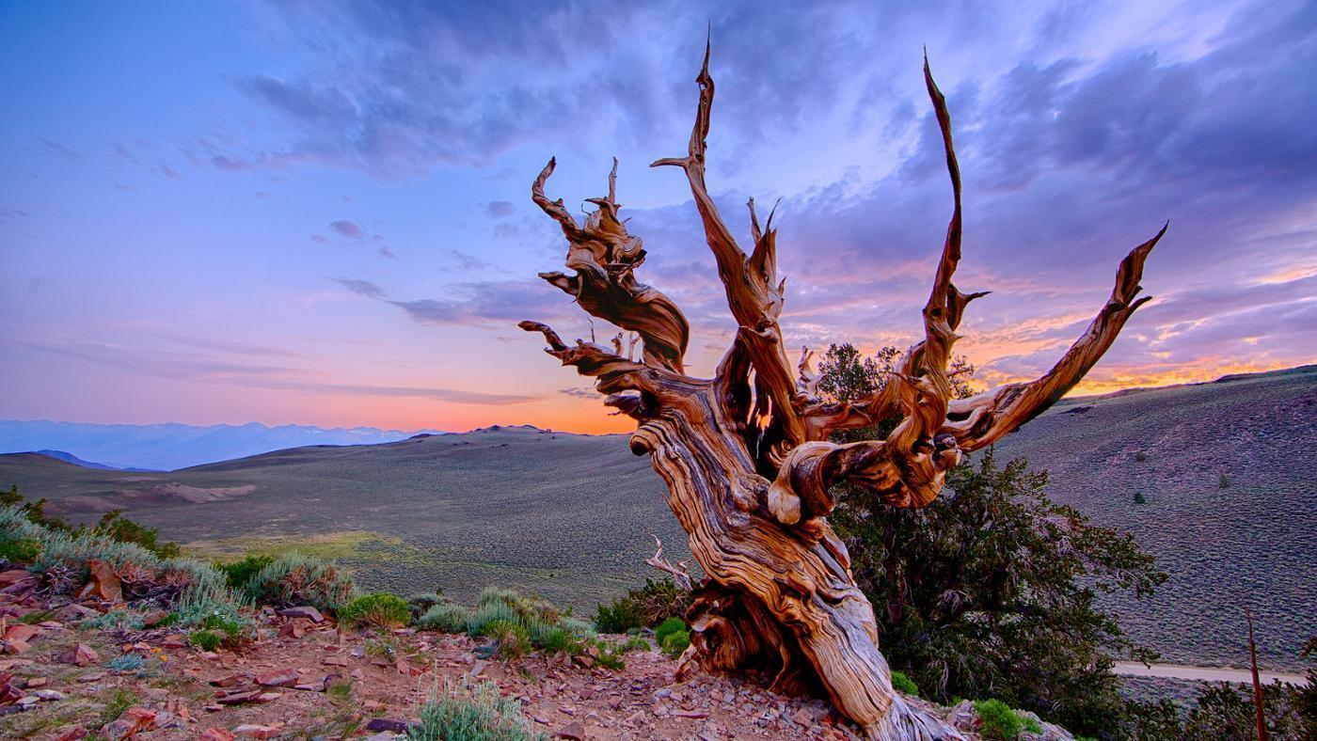
Generating Permutations Tree

Slide 140
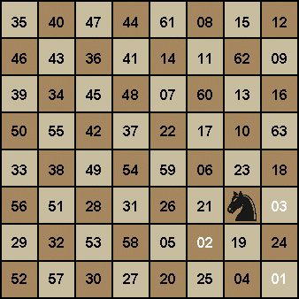
Knights Tour
Knight's Tour Demo

Slide 141
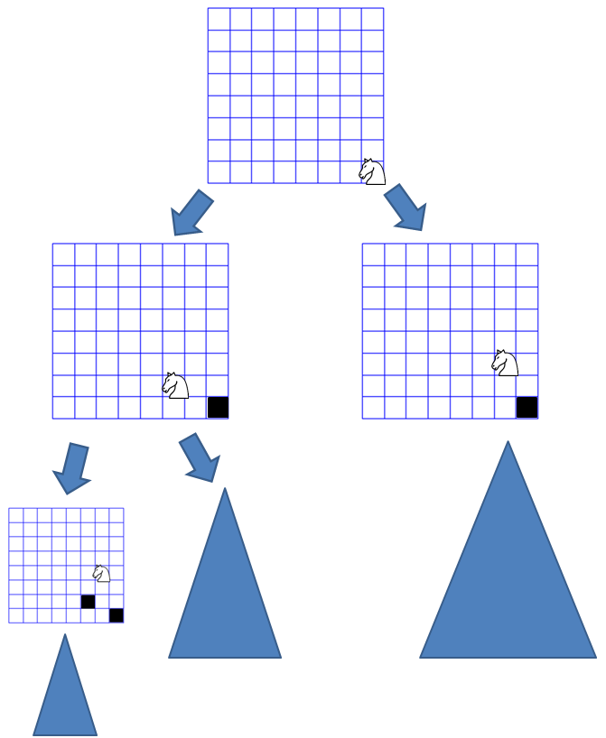
Knights Tour

Slide 142

DNA Alignment

Slide 143
Today’s Goal
Introduction to decision trees.

